Slide 1
Landscape Generation
Project for the course of Deep Learning 2022-2023
Jahrim Gabriele Cesario
jahrim.cesario2@studio.unibo.it
Repository: https://github.com/jahrim/dl-project
Colab: https://colab.research.google.com/drive/1vof-GBruVmq2ZhjEyifVLhNtbRypOBzc?usp=sharing

Slide 2
Business Understanding

Slide 3
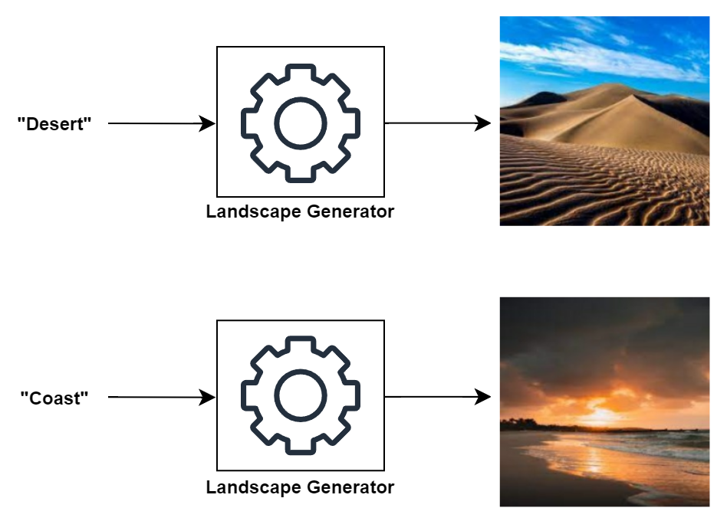
Problem
The goal of this project is to train a generative model capable of creating images representing different kinds of landscapes.
F1. The model should generate different landscape types depending on the given inputs.

Slide 4
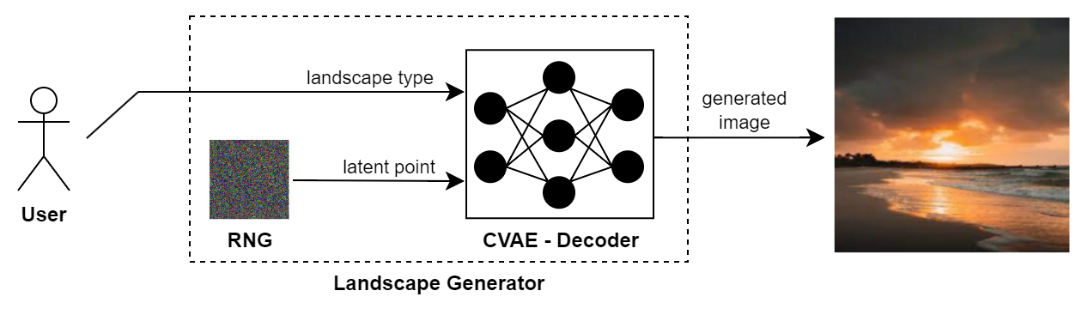
Strategy
To let the user choose the kind of landscape to generate during prediction, the type of generative model trained in this project will be the Decoder of a Conditional Variational AutoEncoder (CVAE).
F2. The user can specify a landscape type to the landscape generator, which will sample a random latent point from the latent space appropriately. Then, the decoder of the CVAE can transform the landscape type and the latent point into a landscape image.

Slide 5
Data Understanding

Slide 6
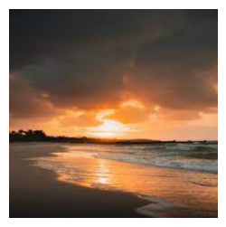
Dataset
The training will be based on the Landscape Recognition Dataset available on Kaggle, which contains 12.000 images of Coasts, Deserts, Forests, Glaciers and Mountains.
Each object of the dataset is a TFRecord containing a 256x256 RGB image bound to a numerical label.
Label Name | Label Id
Coast | 0
Desert | 1
Forest | 2
Glacier | 3
Mountain | 4
256
256
F3. In the dataset, the image of a Coast is bound to the label 0.

Slide 7
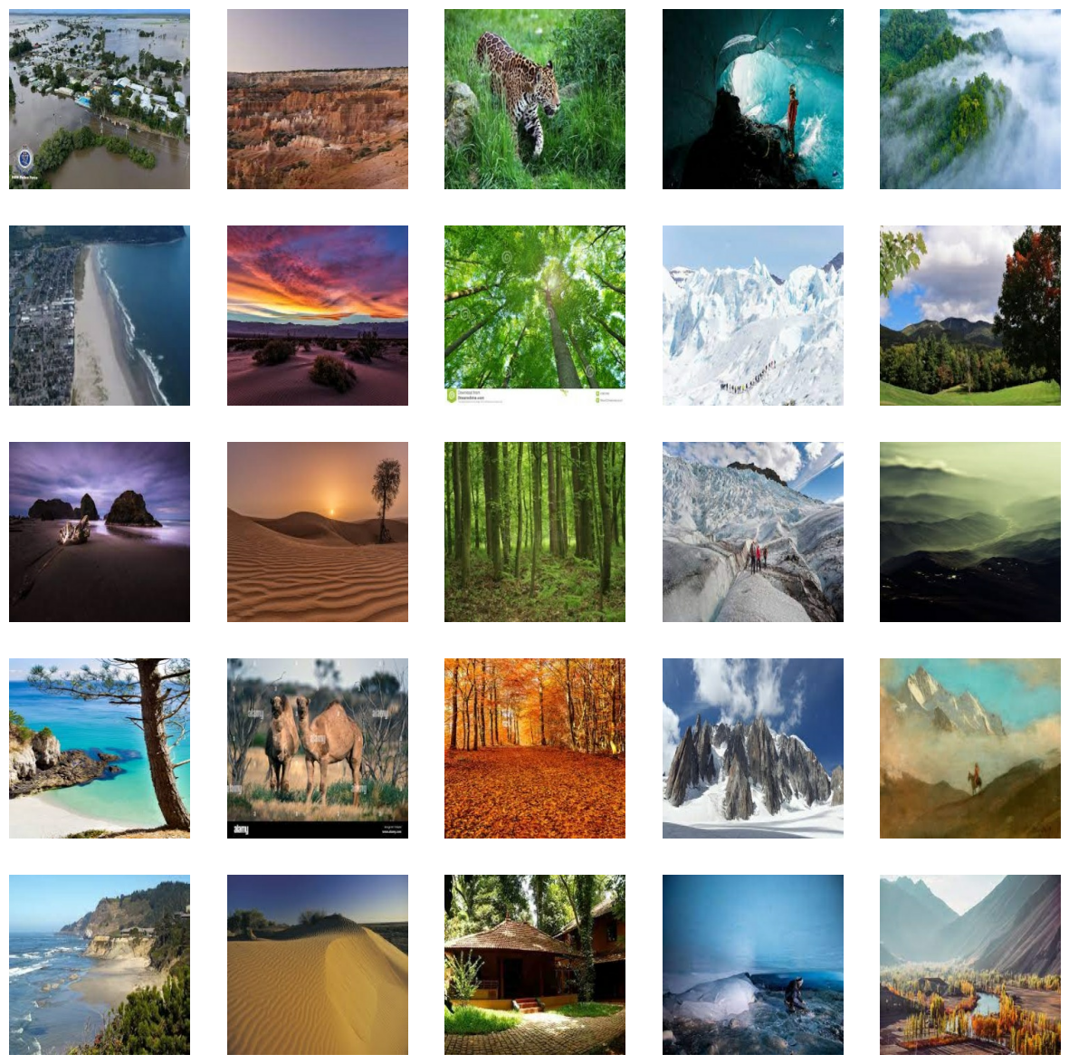
F4. A sample of 25 images extracted from the dataset. Each column contains some pictures of a specific landscape type. In order: Coasts, Deserts, Forests, Glaciers and Mountains (as labelled within the dataset).

Slide 8
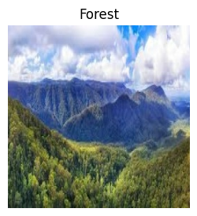
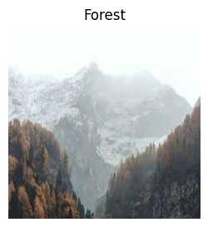
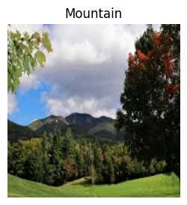
Observations (1/3)
Mixed Landscapes: landscapes are often a mix of different landscape types. The model will have to deal with outliers.
F5. Examples of mixed landscapes.

Slide 9
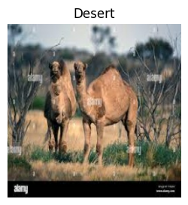
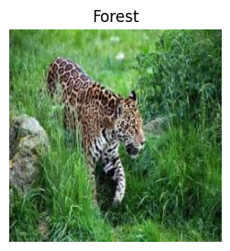
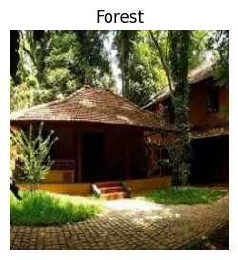
Observations (2/3)
Secondary Subject: landscapes are often a background for the main subjects of the pictures. The model will have to deal with noise.
F6. Examples of landscapes as secondary subjects.

Slide 10
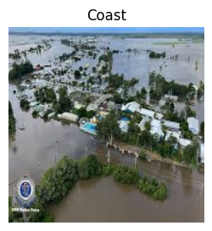
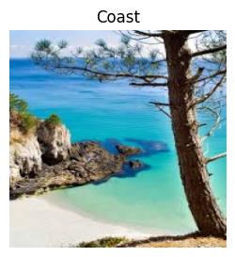
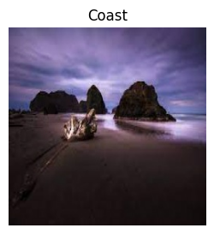
Observations (3/3)
High Variance: each landscape type can be expressed by a large pool of shapes, colors and perspectives. The model will have to learn all these features for each landscape type.
F7. Examples of high variance in coasts.

Slide 11
Data Preparation

Slide 12
Parsing
The TFRecords have been parsed to extract the images and labels of the dataset as tensors.
, 0
TFRecord
image: byte[]
label: int64
parsing
256
256

Slide 13
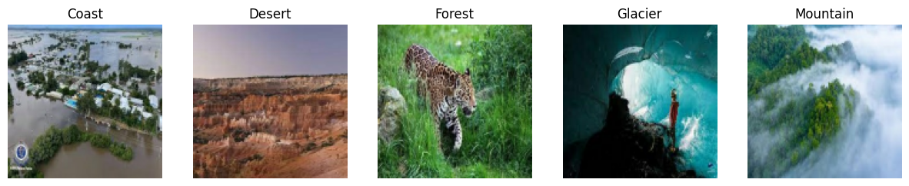
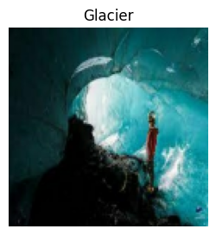
Filtering
In some experiments, the landscape types have been filtered to reduce the variance in the training set, analyzing the performances of the model in different conditions.
only
glaciers

Slide 14
Cropping
The images have been cropped to make sure that they all had the same size.
cropping
256?
256
256?
256

Slide 15
Resizing
In some experiments, the images have also been resized to reduce the complexity of the generation problem.
256
resizing
128
128
256

Slide 16
Normalization
The images have been normalized from values in {0..255} to values in [0; 1] to increase the training stability.
normalization
[1, 0, 0.5, 0.051, …]
[255, 0, 127, 12, …]

Slide 17
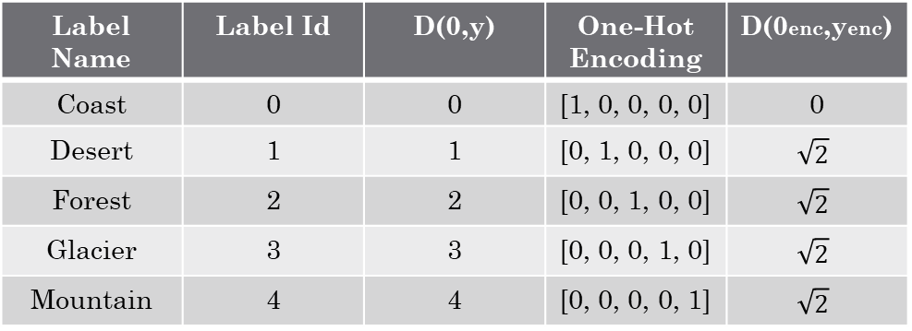
One-Hot Encoding
The labels of the dataset have been transformed using one-hot encoding to forbid the model from inferring similarities between the labels from the similarities between their identifiers.
Label Name | Label Id | D(0,y) | One-Hot Encoding | D(0enc,yenc)
Coast | 0 | 0 | [1, 0, 0, 0, 0] | 0
Desert | 1 | 1 | [0, 1, 0, 0, 0] | $$\sqrt{2}$$
Forest | 2 | 2 | [0, 0, 1, 0, 0] | $$\sqrt{2}$$
Glacier | 3 | 3 | [0, 0, 0, 1, 0] | $$\sqrt{2}$$
Mountain | 4 | 4 | [0, 0, 0, 0, 1] | $$\sqrt{2}$$

Slide 18
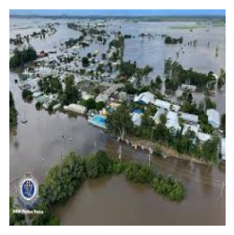
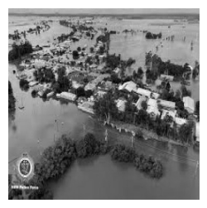
Grayscale Augmentation
In some experiments, the training set has been augmented by transforming the images into grayscale images, with the intention of reducing the amount of focus that the model puts in the colors for distinguishing the different landscape types.
grayscale
augmentation

Slide 19
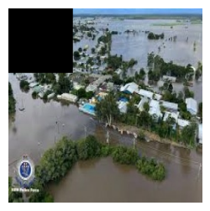
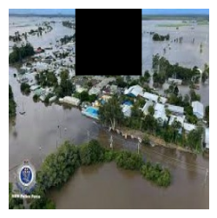
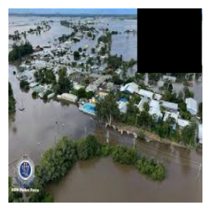
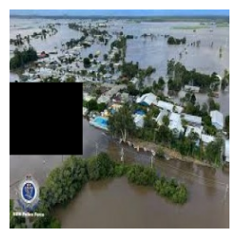
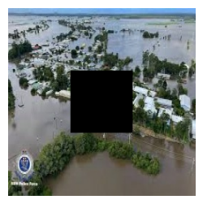
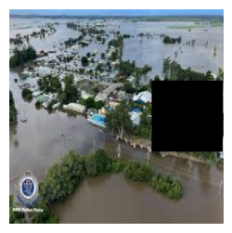
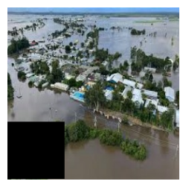
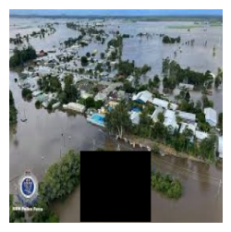
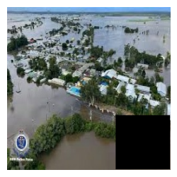
Cut-Out Augmentation
In some experiments, the training set has been augmented by using the Cut-Out method, with the intention of forcing the model to focus on different parts of the images during training.
cut-out
augmentation

Slide 20
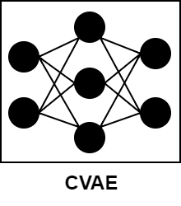
Observations
In retrospective, the effectiveness of the augmentations could have been improved by training the model on different tasks other than reconstructing the original images.
reconstruction
colorization
inpainting
reconstruction

Slide 21
Modelling

Slide 22
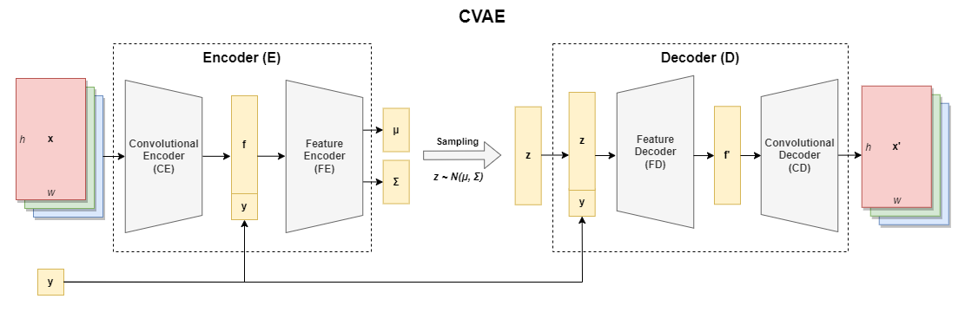
CVAE
In the first experiments, the CVAE included a Convolutional Encoder (Decoder) to map images into features (viceversa) and a Feature Encoder (Decoder) to map such features into points in the latent space (viceversa).

Slide 23
Narrow Variant
CE: deep CNN;
FE & FD: deep FFNN;
CD: reverse of CE;
Features: ~1024-2048;
Weights: ~1-15M;
Graph:

Slide 24
AlexNet Variant
CE: AlexNet with modified outer layers;
FE & FD: deep FFNN;
CD: reverse of CE;
Features: ~4096-9216;
Weights: ~120-320M;
Graph:

Slide 25
Wide Variant
CE: deep CNN with no pooling layers and little compression;
FE & FD: simple FFNN (only output layers);
CD: reverse of CE;
Features: ~65536-1.048.000;
Weights: ~10-600M (heavily dependent on the size of the latent space);
Graph:
Improved Version:

Slide 26
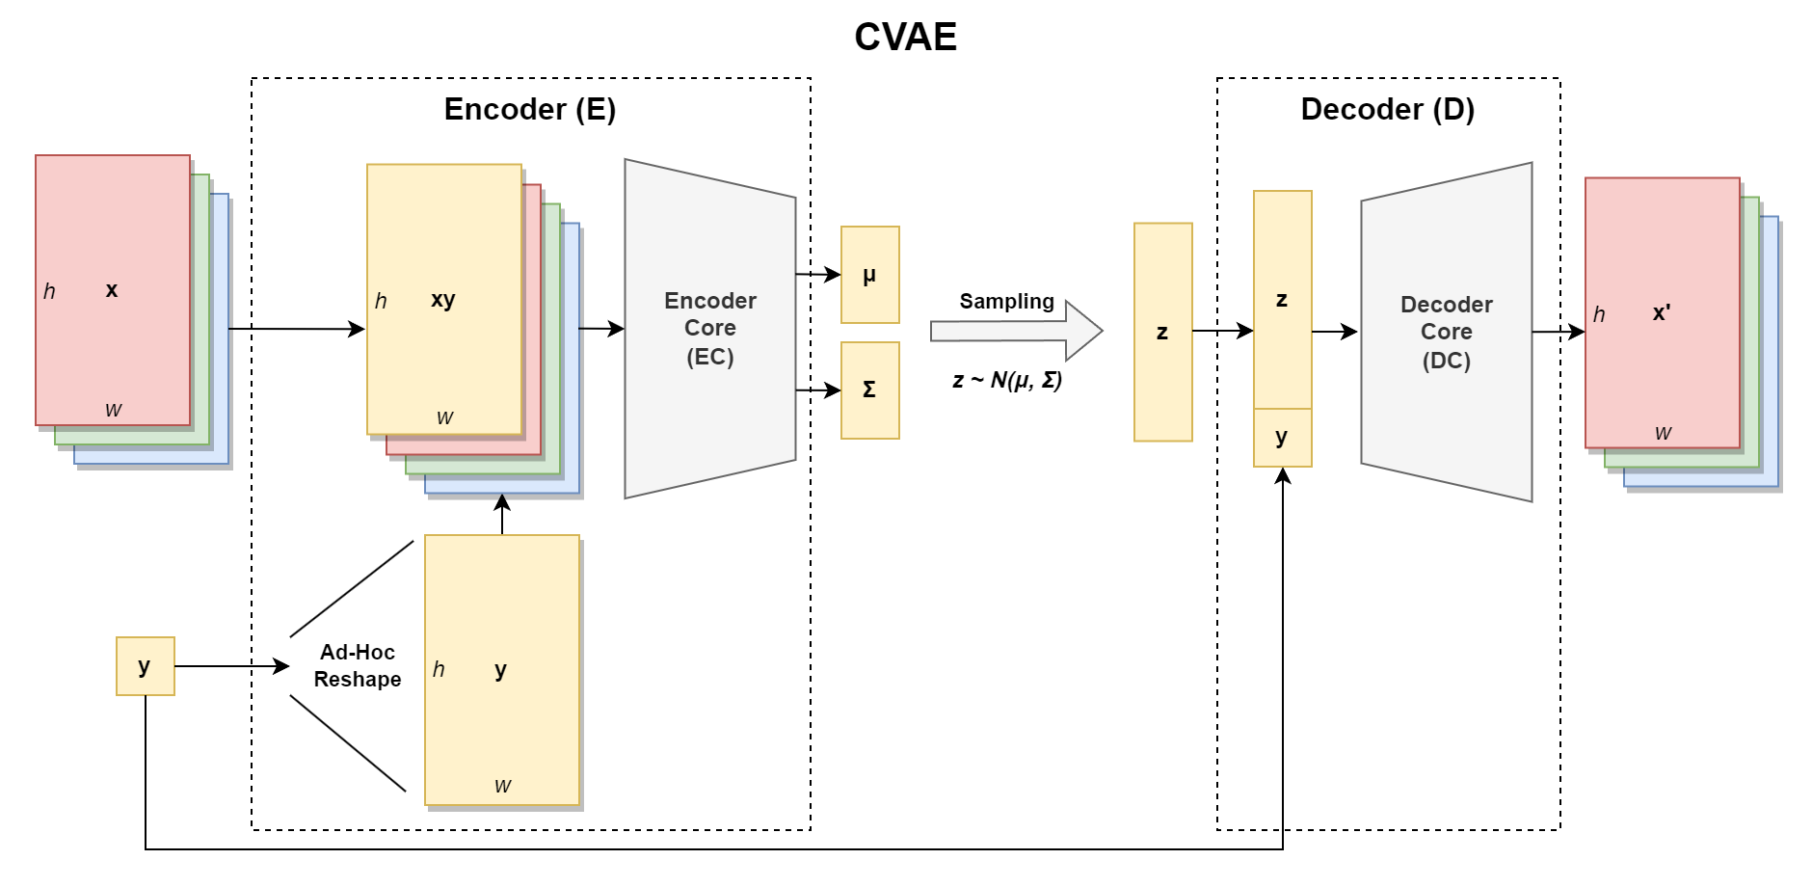
Improved CVAE
In later experiments, the Wide Variant of the CVAE was simplified, including a single component for the Encoder and for the Decoder. Moreover, the features extracted from the images were dependent on the condition.

Slide 27
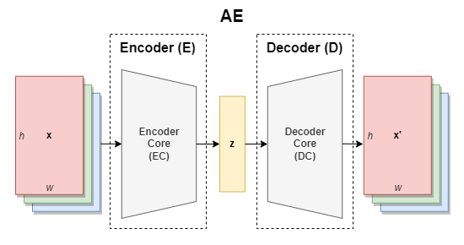
AE
In order to test the reconstruction capabilities of the model, an Undercomplete AutoEncoder with a similar architecture has been trained as well.

Slide 28
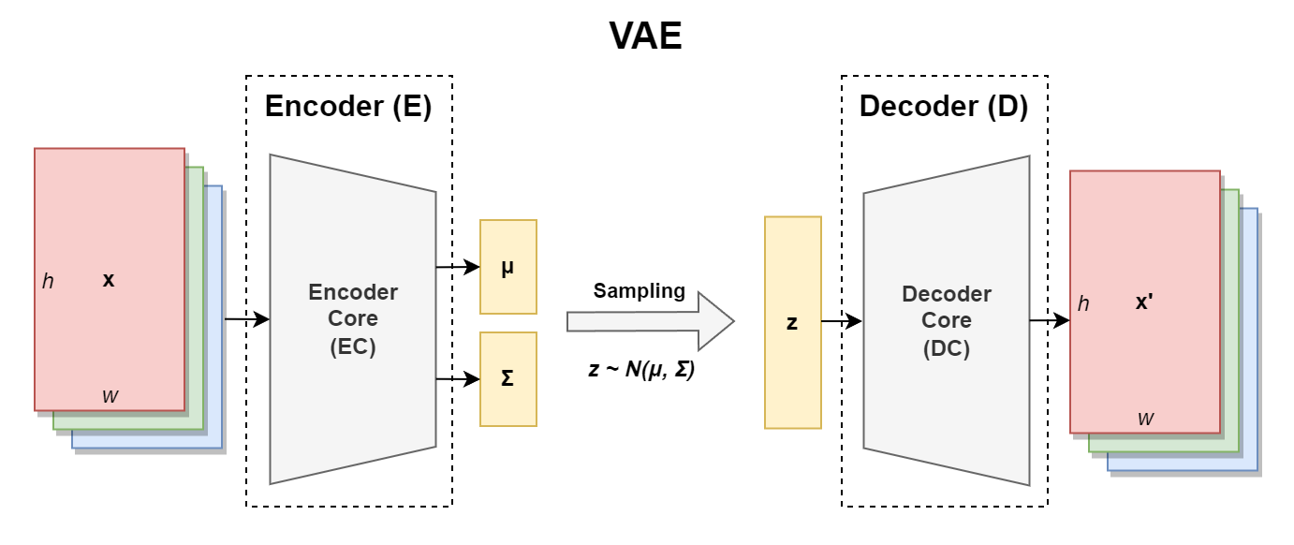
VAE
For further testing involving also the generation capabilities of the model, a Variational AutoEncoder with a similar architecture has been trained as well.

Slide 29
Evaluation

Slide 30
Thank you.

Slide 31
End

